Slide 1
A worked out problem # 01
A home owner is considering whether to invest in solar panels. This homeowner has gathered the following information for her town:
The average cost for residential energy is $ 0.124/kWh
The government subsidizes 70% of whatever is invested by the household.
Each square foot of panel produces 19.13 kWh every year.
The cost of installation per square foot of solar panel is $ 93.91
The house has 350 sq. ft of roof space. What is the break even point in years for the installation of solar panels? Assume the homeowner’s interest rate is 6% per year.
The question is asking us to calculate the breakeven point in number of years where the savings through solar panel would equal the amount of investment. Therefore, what we need to do is to calculate the amount saved for each year and then convert the value of each year to its present worth. Plotting the data points will lead us to the breakeven point ( Graphical solution)

Slide 2
A worked out Example # 01
The breakeven point is where the annual savings from the solar panels offsets the initial investment. The initial investment is calculated as follows:
350 sq. ft of roof space x $93.91/sq.ft = $ 32, 869
With a 70% government subsidy, the purchase price is (0.3) ( 32,869) = $9,861
To find the break even point in years (X), we set the purchase price equal to the potential energy savings
$ 9,861 = ( 350 sq.ft) (19.13 kWh/sq.ft-year) ($0.124/kWh) (P/A, 6%,X)
$9,861 = ( $ 830.24) (P/A,6%, X)
11.87 = (P/A, 6%, X)
From the interest table we could see that some where between 21 and 22 years we get the factor of 11.87 . Therefore, we say that approximately, it would take 22 years to breakeven the investment cost.

Slide 3
A worked out Example # 02
Hybrid vehicles save on gasoline consumption by shutting off the vehicle’s engine while idling, giving the vehicle a boost of electric power during acceleration, and capturing electrical energy while braking. In addition to environmental benefits, the primary monetary benefit to the owner is reduced fuel cost as a result of improved gas mileage. The trade-off, however, is that the purchase price of the hybrid vehicle is higher than that of a standard-gasoline fueled engine.
Consider a hybrid vehicle with a price tag of $ 31,500. This vehicle will average 30 miles per gallon of gasoline. A tax credit of 1,500 for the hybrid vehicle effectively reduces its price tag to $ $30,000. A comparably equipped gasoline-only vehicle will cost $ 28,000 and will average 25 miles per gallon of gasoline. Assuming an interest rate of 3% per year and a study period of five years, find the breakeven of gasoline ($/gal) if the vehicle will be driven 18,000 miles each year.
To find the cost of gasoline that makes you indifferent between the two vehicles, you need to develop an equivalent-worth equation in terms of the factor of interest – the cost of gasoline. In this simple example, we are only considering the investment cost and fuel cost (annual expenses). By default, we are assuming that the maintenance of the two vehicles will be the same as will the future resale value.

Slide 4
A worked out Example # 02
In this problem, we develop equivalent uniform annual cost (EUAC) expressions for each of the vehicles.
Letting X = cost of gasoline, we get the following EUAC equations.
Hybrid : EUAC – Hybrid = (31,500 – 1,500) (A/P,3%,5) + $X/gal [(18,000 mi)/Year/ 30 mi/gal)]
Gas-only: EUAC-Gas only= 28,000( A/P,3%,5)+ $X/gal [ 18,000 mi/Year/ 25 mi gallon)]
Equating both the equations and solving for X, breakeven cost of gasoline will come out to be $3.64/gallon.

Slide 5
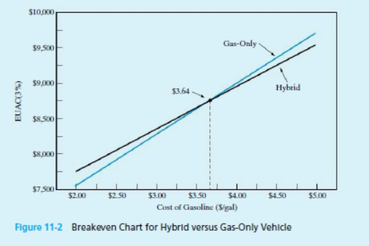
A worked out Example # 02

Slide 6
A worked out Example # 03
Consider a project that may be constructed to full capacity now or may be constructed in two stages.
Construction Alternative | Costs
Two Stage Construction
Construct First Stage Now | $100,000
Construct second stage n years from now | 120,000
Full capacity construction
Construct Full Capacity Now | 140,000
Other Factors:
All facilities will last for 40 years regardless of when they are installed; after 40 years, they will have zero salvage value.
The annual cost of O&M is the same for both two-stage construction and full capacity construction
Assume 8% interest rate.
Plot “age when second stage is constructed” versus “costs for both alternatives”. Mark the break even point on your graph.

Slide 7
A worked out Example # 03
Construct Full capacity now
PW of Cost =$140,000
Two stage Construction
If the first stage is to be constructed now and the second stage n years hence, compute the PW of cost for several values of n (years).
PW of Cost = 100,000 + 120,000 (P/F,8%,n)
N=5 PW = 100,000+ 120,000(0.6806) = $181,700
N=10 PW = 100,000 + 120,000 (0.4632) = $155,600
N=20 PW = 100,000 + 120,000 (0.2145) = 125,700
N=30 PW = 100,000 + 120,000 (0.0994) = 111,900

Slide 8
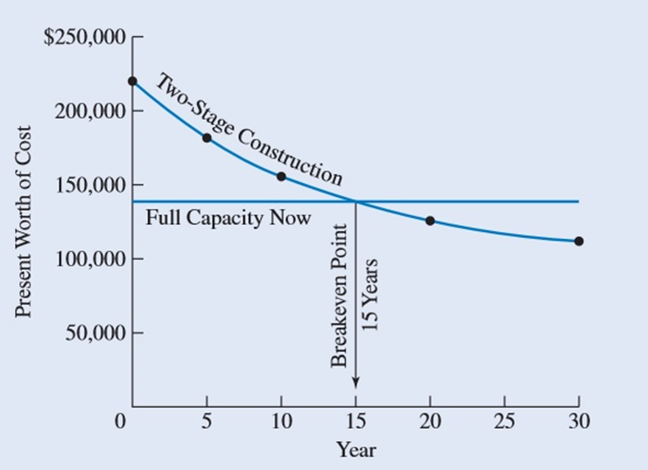
A worked out Example # 03

Slide 9
A worked out Example # 03
Discussion
It is to be seen that the PW of cost for two-stage construction naturally decreases as the second stage is deferred. The one-stage construction (full capacity now) is unaffected by the x-axis variable and, hence, is a horizontal line.
It is further to be seen that if the second stage is deferred for 15 years, then the PW of cost of two stage construction is equal to one-stage construction; Year 15 is the break even point. The graph also shows that if the second stage were to be needed prior to year 15, the one stage construction, with its smaller PW of cost, would be preferred. On the other hand, if the second stage would not be required until after 15 years, the two stage construction is preferred.
The break even point can also be calculated by setting the two alternatives equal to ach other.
PW = 140,000 = 100,000 + 120,000 (P/F,8%,n)
(P/F,8%,n) = 40,000/120,000 = 0.3333
N= 15 years.

Slide 10
A worked out Example # 04
 | A | B | C
Initial cost | 2000 | 4000 | 5000
Uniform annual benefit | 410 | 639 | 700
It is given that Alternative B is a better alternative. If this alternative is selected as a better alternative, it means that Alternative B will hold this position when for all the values less than $4000 also. Therefore, what we need to do is to find the value above 4000 at which the alternative B keeps the label of being the best alternative among others.
For this to happen,
NPW-A = 410 ( P/A, 6%,20) -2000
=410 (11.470)-2000
=$2703$
Let x = initial cost of B
NPW-B = 639 (P/A, 6%,20)-x = 639 (11.470) – x = 7329 - x

Slide 11
A worked out Example # 04
 | A | B | C
Initial cost | 2000 | 4000 | 5000
Uniform annual benefit | 410 | 639 | 700
NPW - C = 700 ( P/A, 6%,20) – 5000
= 700 (11.470)-5000 = $3029
Seeing the alternatives closely, we could see that NPW of B will only maximize as long as NPW is greater than 3029.
Therefore,
3029 = 7329 – x
x = 7329 – 3029 = $4300
Therefore, B is the preferred alternative if its initial cost does not exceed $4300.

Slide 12
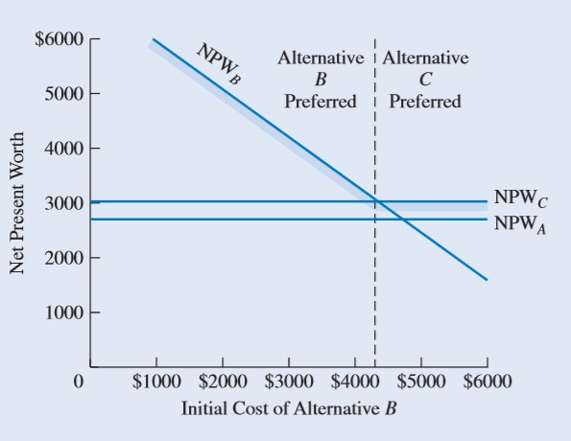
A worked out Example # 04
Graph in the previous slide is a breakeven chart for the three alternatives. Here the criterion is to maximize NPW; as a result, the graph shows that B is preferred if its initial cost is less than $4300. At an initial cost above $4300, C is preferred. We have a breakeven point at $4300. When B has an initial cost of $4300, B and C are equally desirable.

Slide 13
Thank You

